Slide 1
English 8
UNIT 5 . FESTIVALS IN VIET NAM
PERIOD 38: COMMUNICATION
Welcometo our class
Teacher: Nguyen Thi Hien
Long Bien Secondary School

Slide 2
Unit 5: Festivals in Viet Nam
Lesson 4: Communication

Slide 4
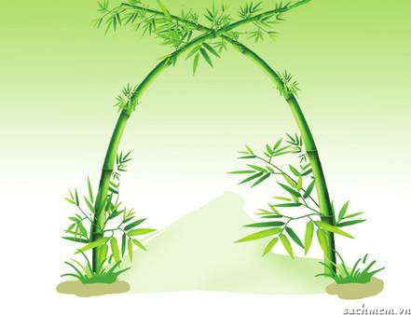
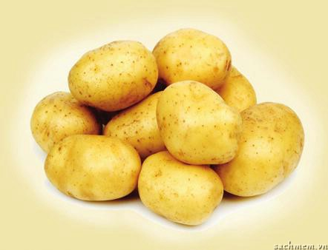
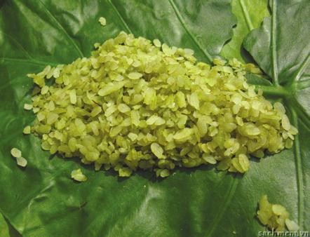
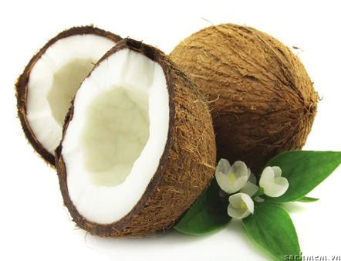
1. Look at the pictures. Discuss the following questions with a partner and then write the right words under the pictures.
a. What are the things in the pictures?
bamboo archway
potatoes
green rice flakes
coconut

Slide 5
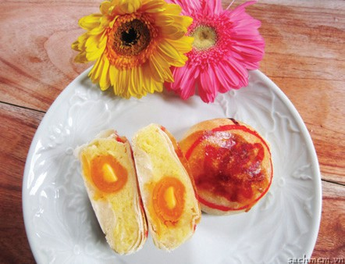
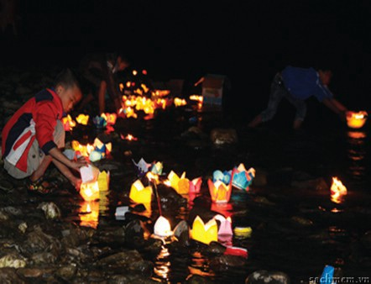
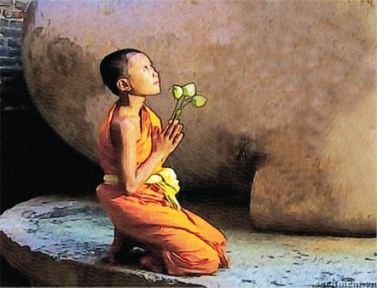
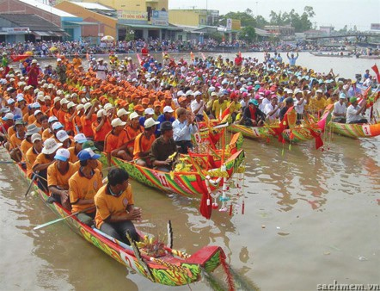
pia cake
lanterns
dragon boat race
clasped hands

Slide 6
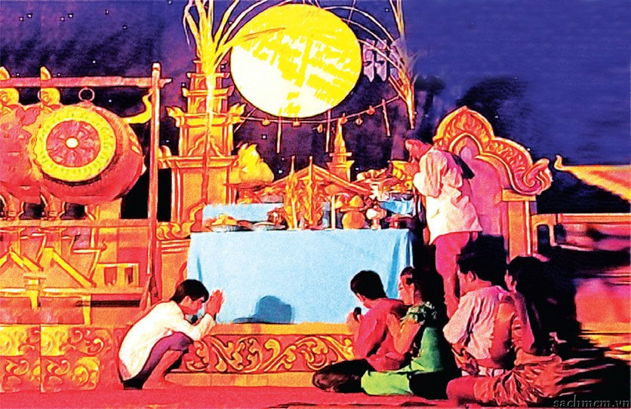
2. Now listen to an interview between a TV reporter and a man about a festival to check your answers.
b. Do you know the festivals at which they appear?

Slide 7
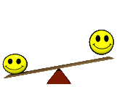
Ooc bom boc festival

Slide 8
3. Listen to the interview again and complete the table below with the answers to the suggested questions.
Where? | 1. ____________________
When? | 2._____________________ ______________________
Who is worshipped? | 3. ____________________
What activities? | 4.___________________________________________ 5. ____________________ 6. ____________________
Soc Trang
14th, 15th evenings of the 10th lunar month
Moon God
have a worshipping ceremony
float paper lanterns
hold dragon boat races

Slide 9
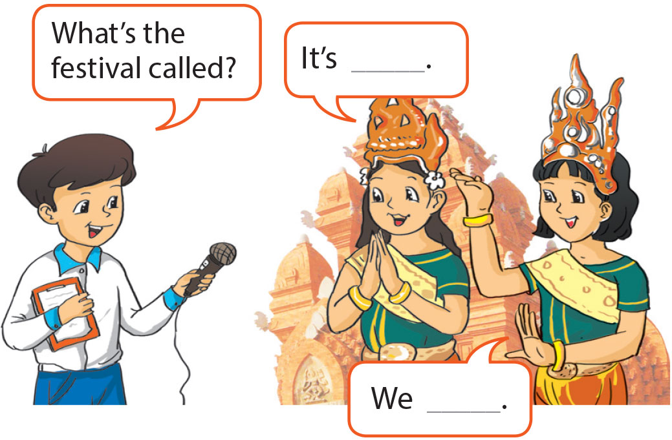
4. Role-play in groups of three. One of you is a reporter; two of you are locals. Do an interview about a local festival. It can be a real or an imaginary festival.
Example:
A: Good morning. Can I ask you some questions about this festival?
B: Yes, of course.
A: What is the festival called?
B: It's ____. It's held in ____.
A: Who do you worship at the festival?
C: We worship ____.

